Slide 1

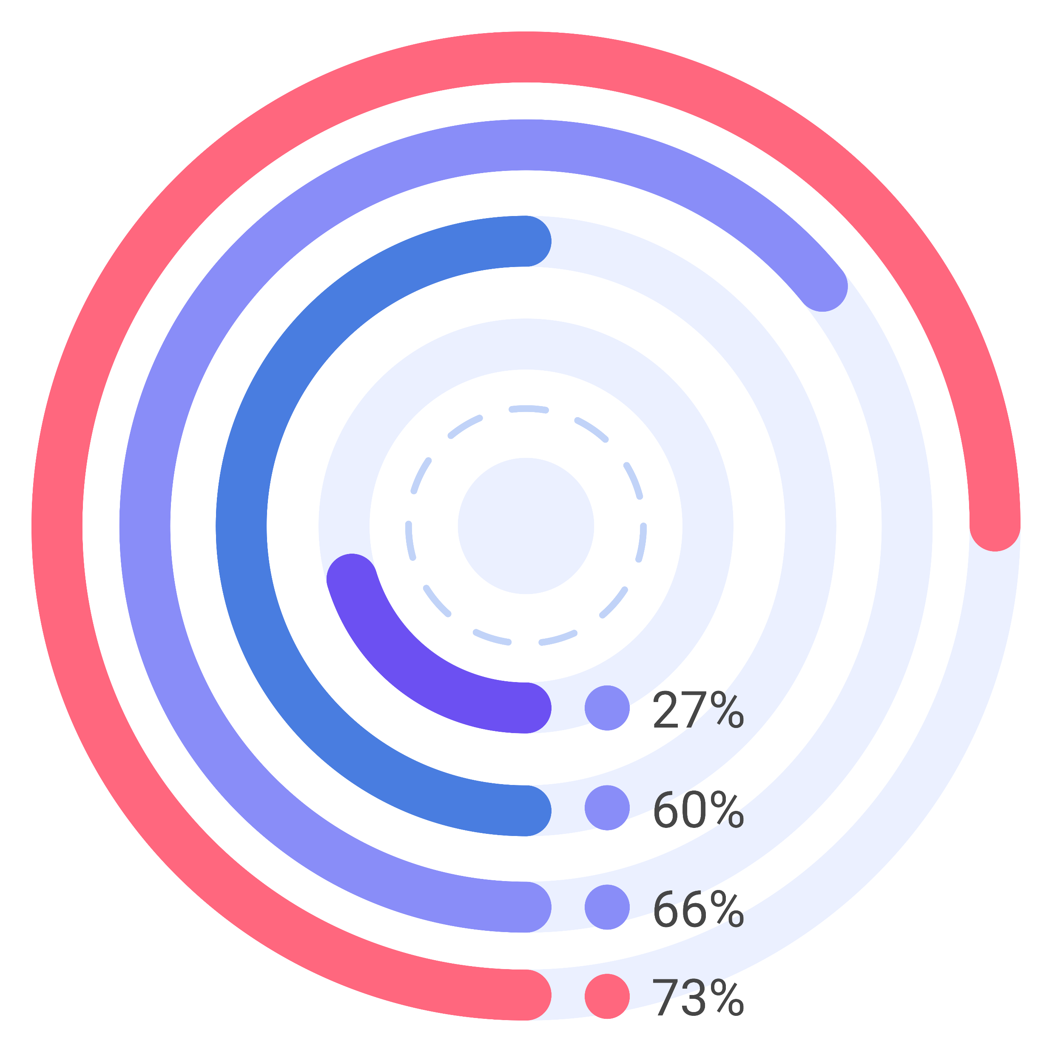
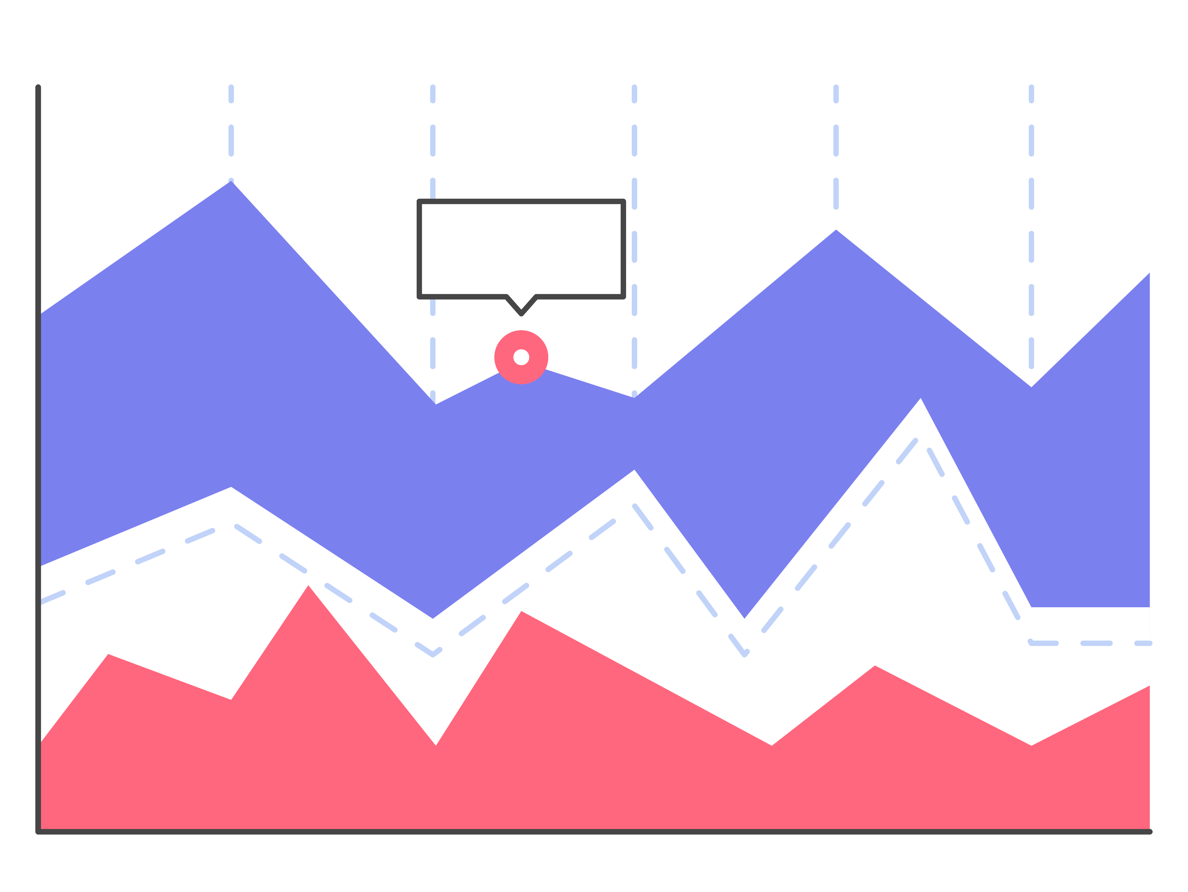
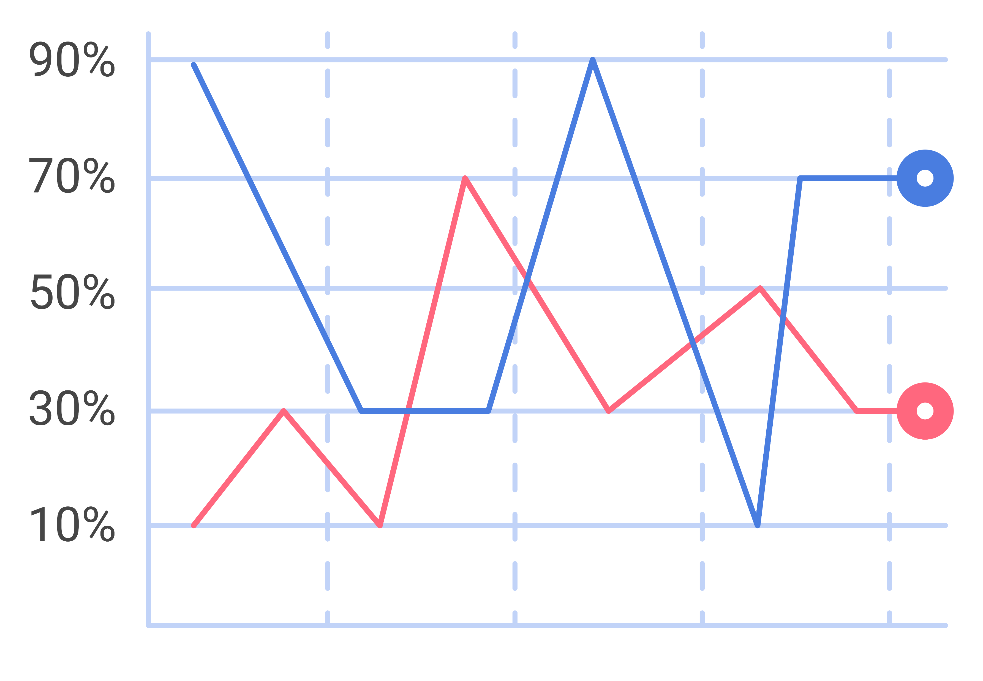
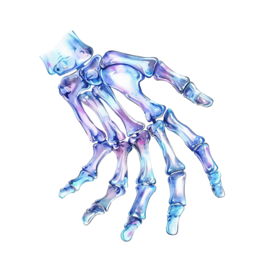

TEACH PEOPLE WHAT YOU LEARNED IN 5 SECONDS (takeaway, not title)
Poster title goes here
Authors, FIRST NAME INITIAL, SURNAME, presenting author(s) underlined, Affiliations1 numbered in superscript)
e.g. B. SMITH ¹, N. HARRISON ² ² and P. MATTHEWS²
1 University of New South Wales, Sydney, Australia
2 Royal Brisbane Hospital, Brisbane, Australia
Background
70,000 people needed a portrait-orientation style layout for #betterposter, according to the Open Science Framework downloads counts.
Results
Result 1: Quickly explain what the graph shows. Help people think
Result 2: Big figures are easier to skim at a distance and more accesible
Result 3: Big figures are easier to skim at a distance and more accesible
Method
Tips for making a successful poster…
Re-write your paper into poster format i.e.. simplify everything, avoid data overkill.
Headings of more than 6 words should be in upper and lower case, not all capitals. Simplify the titles.
Try not to write whole sentences in capitals or underline to stress your point, use bold characters instead.
Add images/graphics if possible. Don’t overcrowd your poster.
Spell check and get someone else to proof-read.
Summary/ Highlights
This is only one interpretation of findings that suggest effective posters are uncluttered, have big figures & text, and include a callout boxes with takeaways. It is missing your personality and creative flair.
References
Contact information
Just highlight this text and replace with your own text.
Just highlight this text and replace with your own text.

